Slide 1
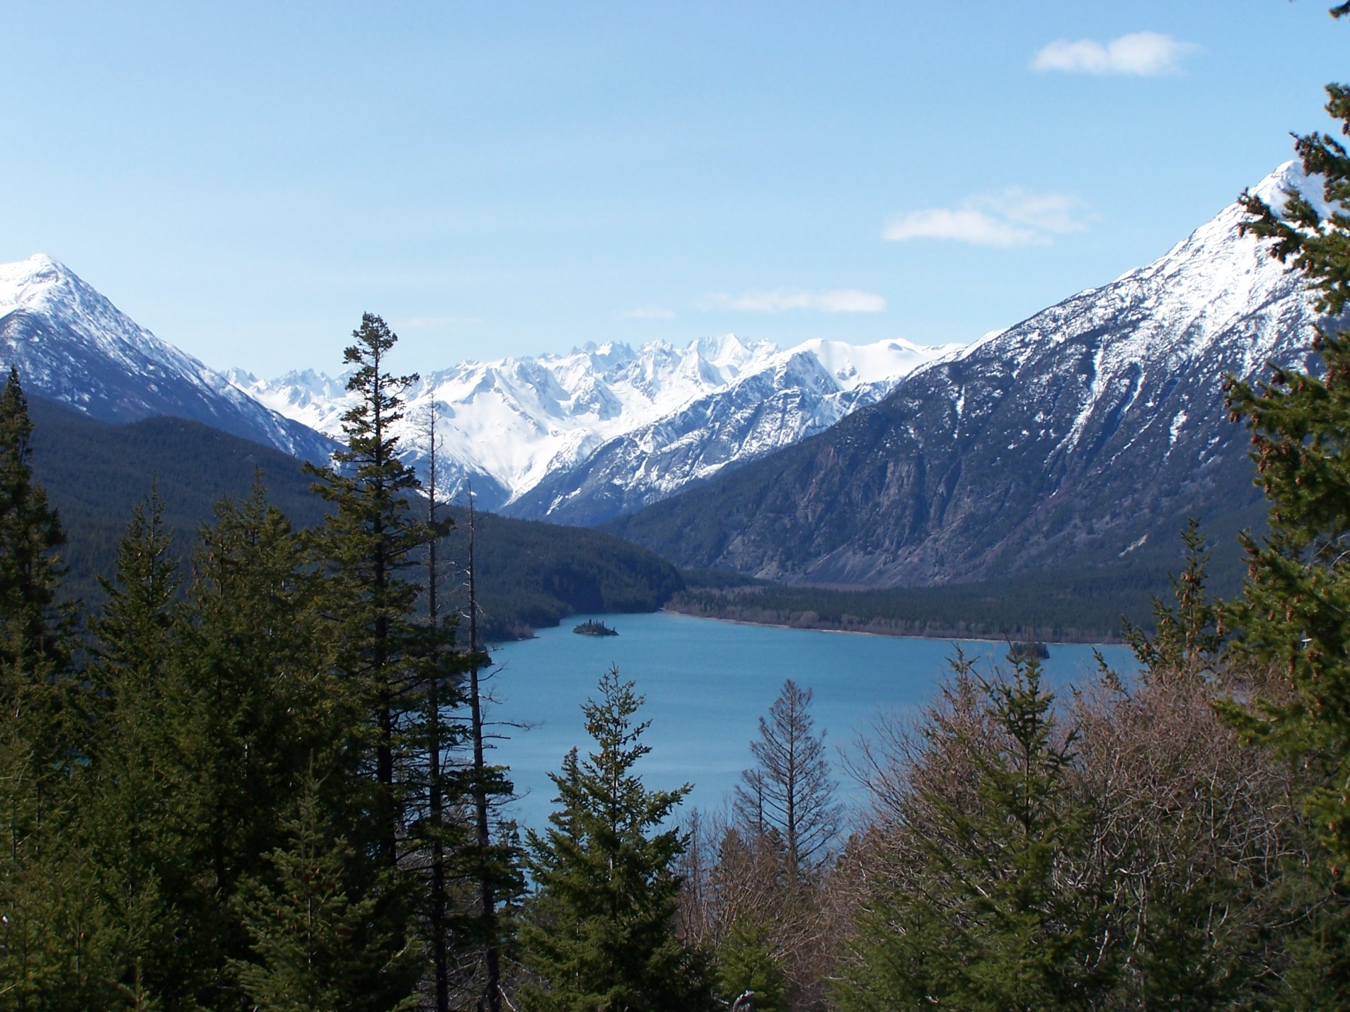
Root Disease in the IDF
Root Disease in the IDF

Slide 2
Two root diseases
Armillaria root rot - Armillaria ostoyae or Armillaria solidipes
Affects all species of trees but Douglas-fir is one of the most susceptible tree species
Closely related species Armillaria sinapina which kills deciduous trees but is saprophytic on dead conifers
2) Laminated root rot – Inonotus sulphurascens (formerly Phellinus weirii Douglas-fir type)
main host is Douglas-fir
commonly occurs with Armillaria in Thompson/Okanagan but less common in the Cariboo

Slide 3
Distribution and Impact
common in T/O IDF less common in Cariboo IDF
T/O dry IDF more common on north and east aspects
no root rot on the Chilcotin Plateau (too cold) but reoccurs west of Mosley Creek drainage in the IDFdw
Bigger problem in the ICH and SBSdw1 especially on low elevation south facing slopes

Slide 4
Stealth pathogens/ diseases of the site
Spread via root contacts or short distances through soil (Armillaria)
Hang out and wait for host to come to them
Once they infect their host they kill them very slowly (older trees)
They can survive long periods of time on the dead roots of their hosts (50 years or more)
New long distance spread via spores is rare

Slide 5
Method of spread can result in formation of root rot centers
Middle of center is open and contains younger trees
As you move outwards from the middle you begin to see snags and blow down
Symptomatic trees along edge
For laminated root rot and severe Armillaria there is often a sharp contrast at the edge of the center as you go from killed trees to symptomatic and healthy mature trees (discrete and easy to map)
Armillaria can also occur as scattered mortality with no clearly defined boundary between healthy and diseased trees (indiscrete and very difficult to map)

Slide 6
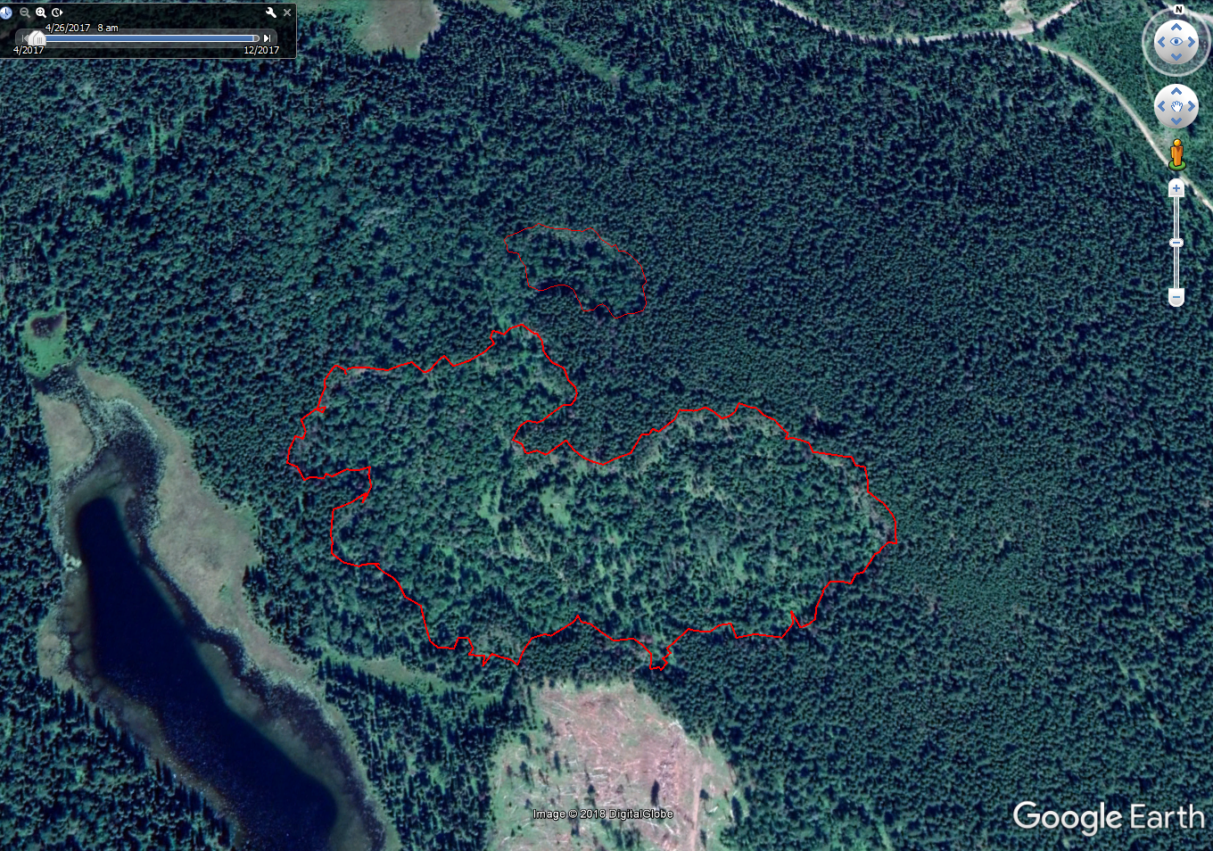
Larger Centers can be mapped from the air and included in future inventory labels (Big Lake)

Slide 7
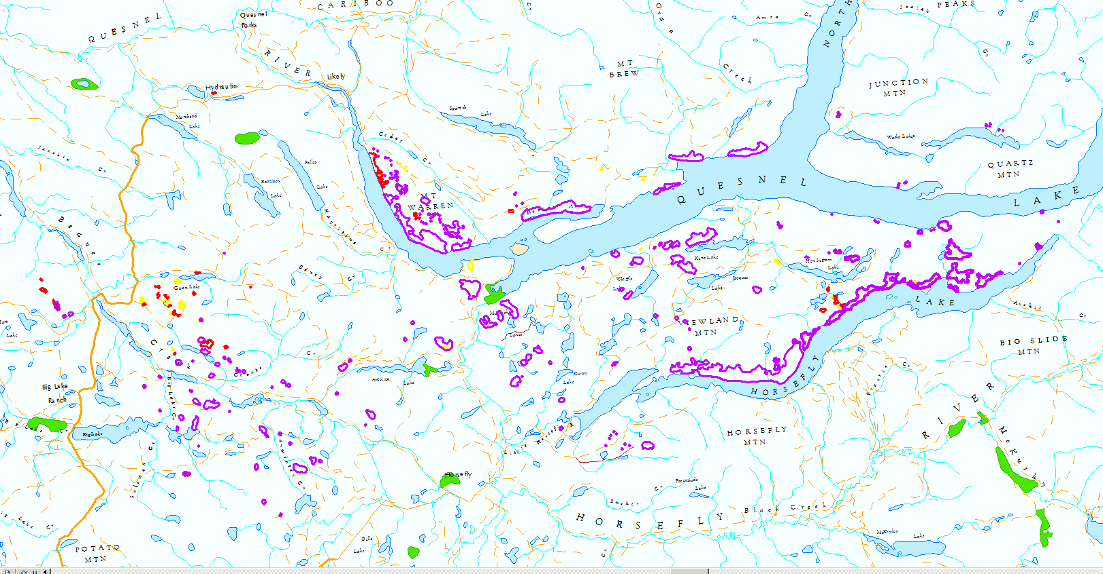
Aerial Root Rot Mapping

Slide 8
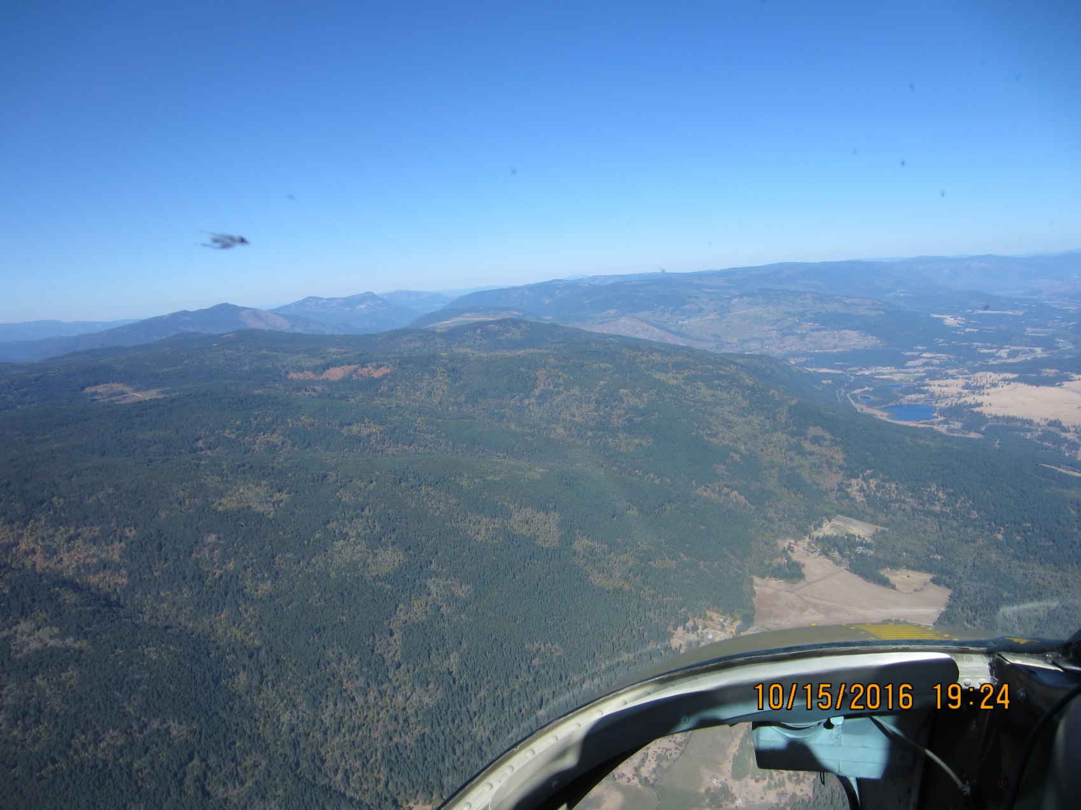
Root rot centers from a bird’s eye (Falkland)

Slide 9
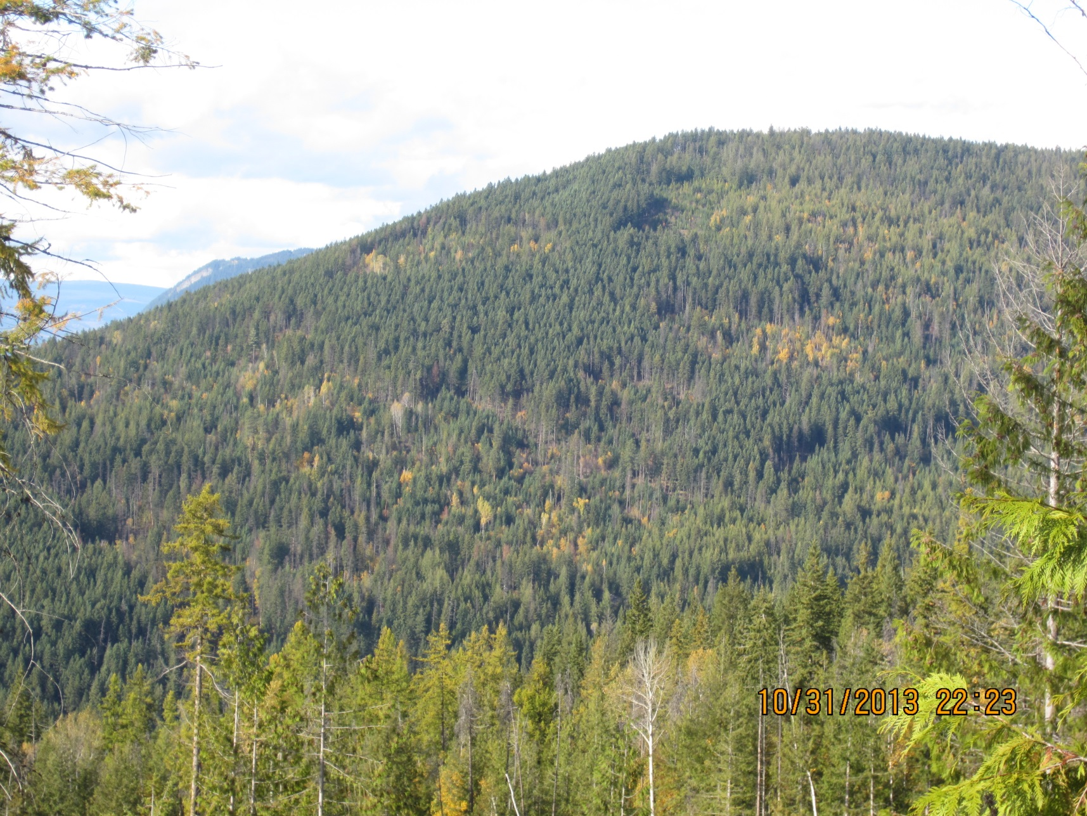
A little closer (Salmon Arm)

Slide 10

Closer (Middle Lake)

Slide 11
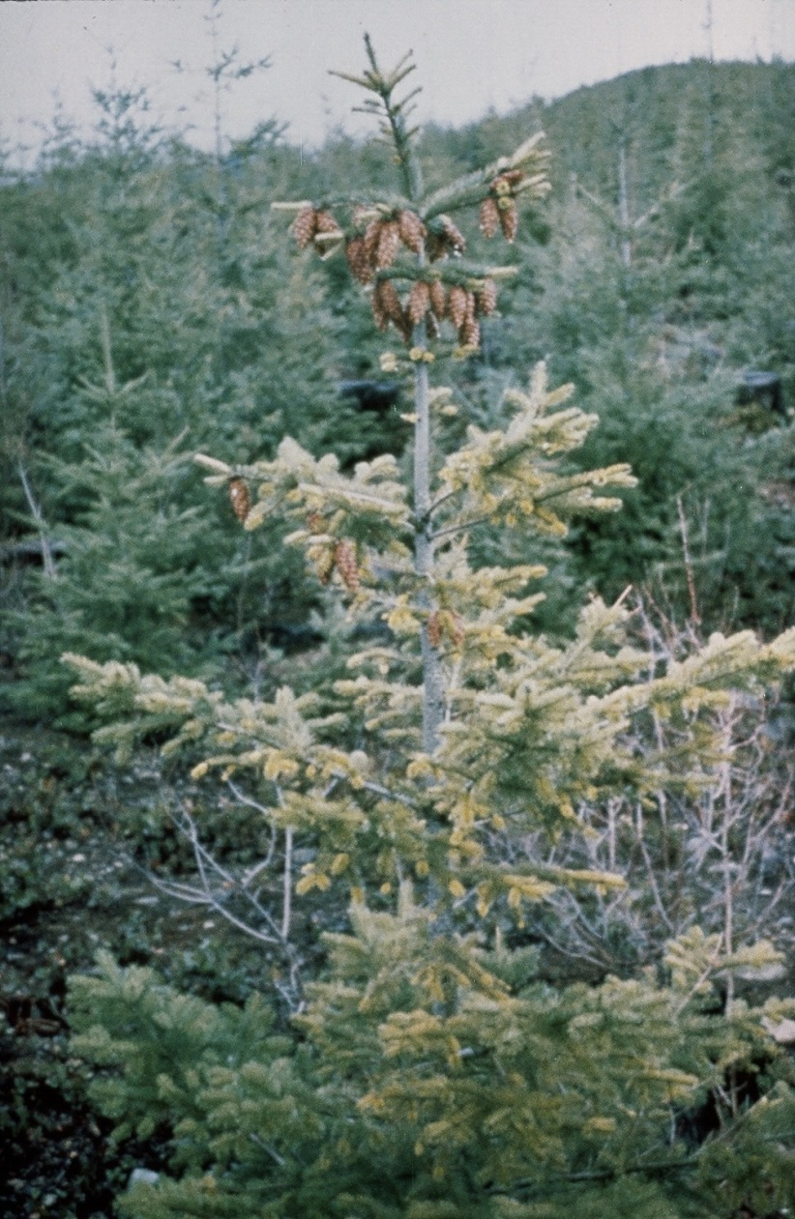
Armillaria or Laminated?

Slide 12
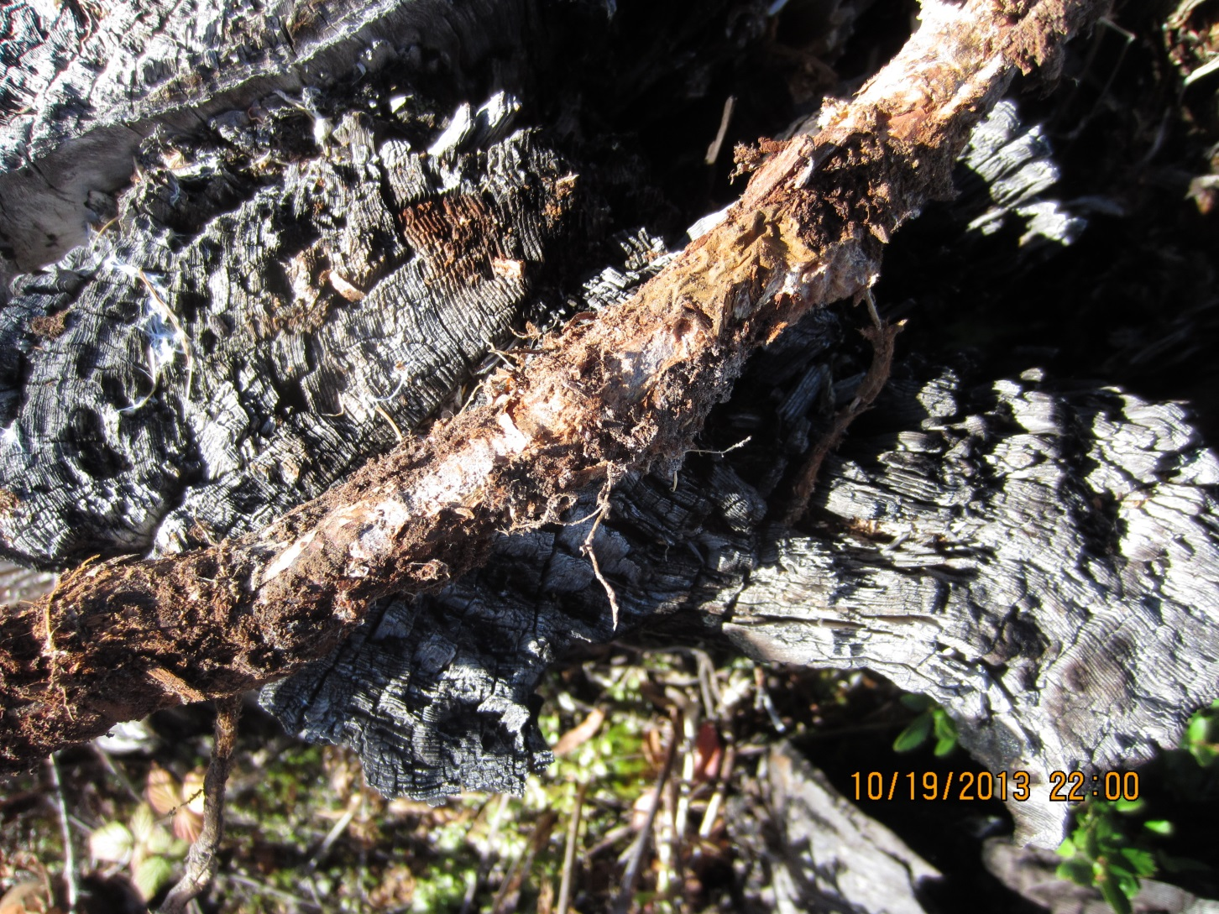
Laminated ectotrophic mycelium

Slide 13
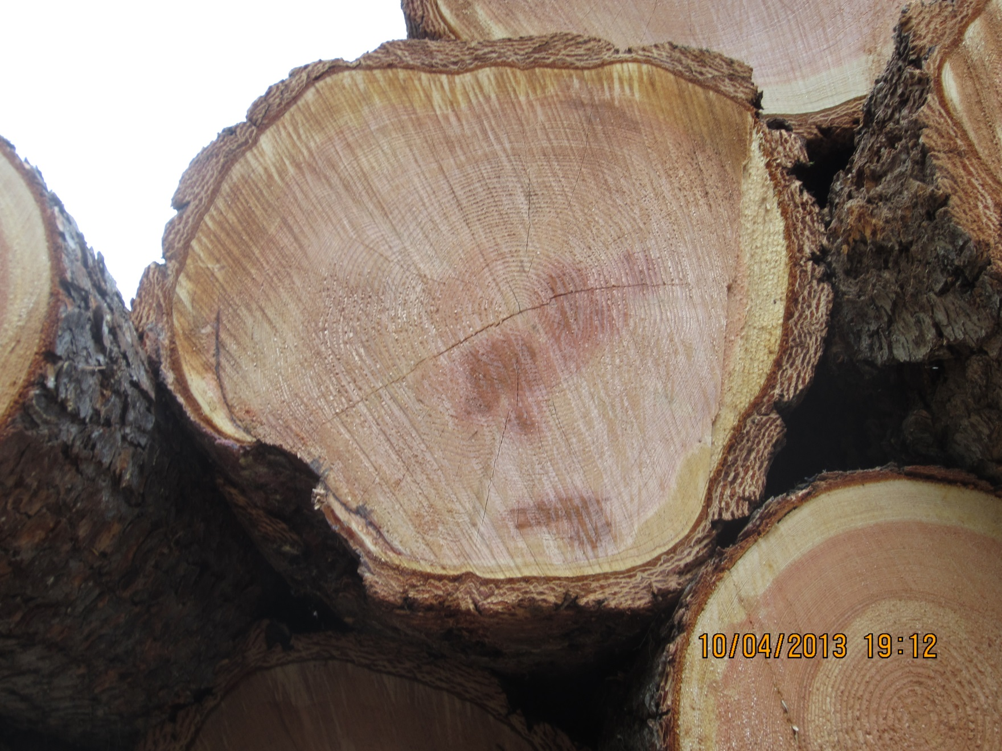
Laminated Stain

Slide 14
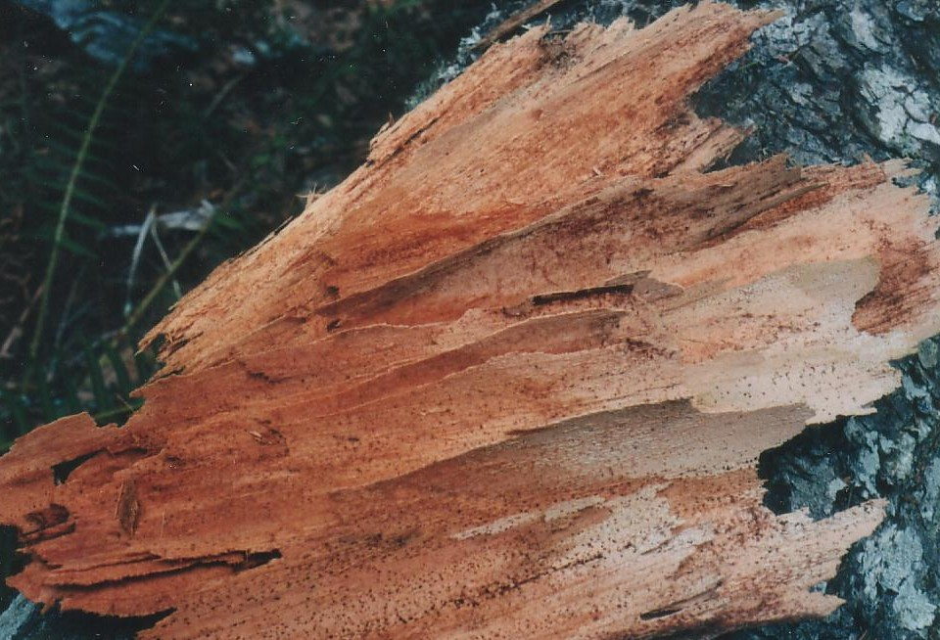
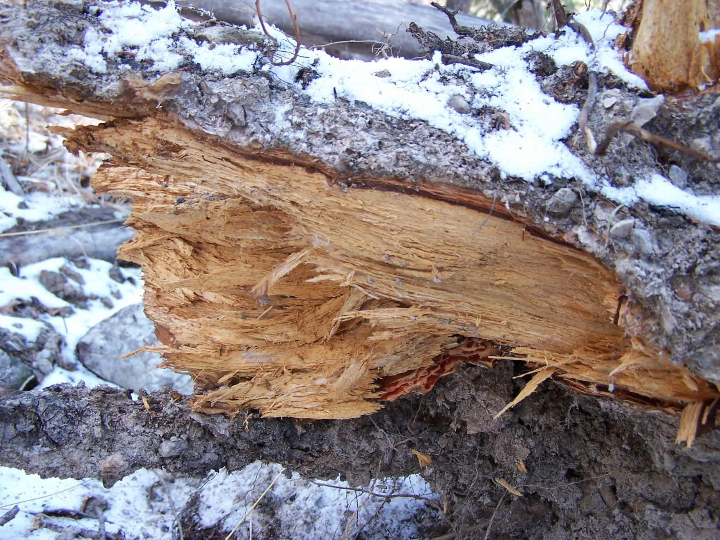
Delaminated Decay

Slide 15
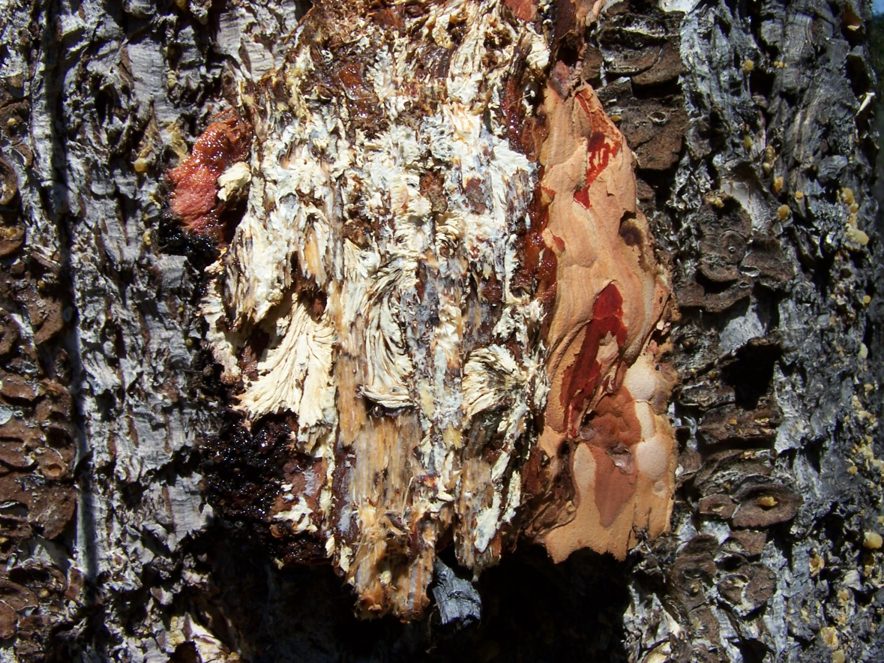
Armillaria fans in cambium

Slide 16
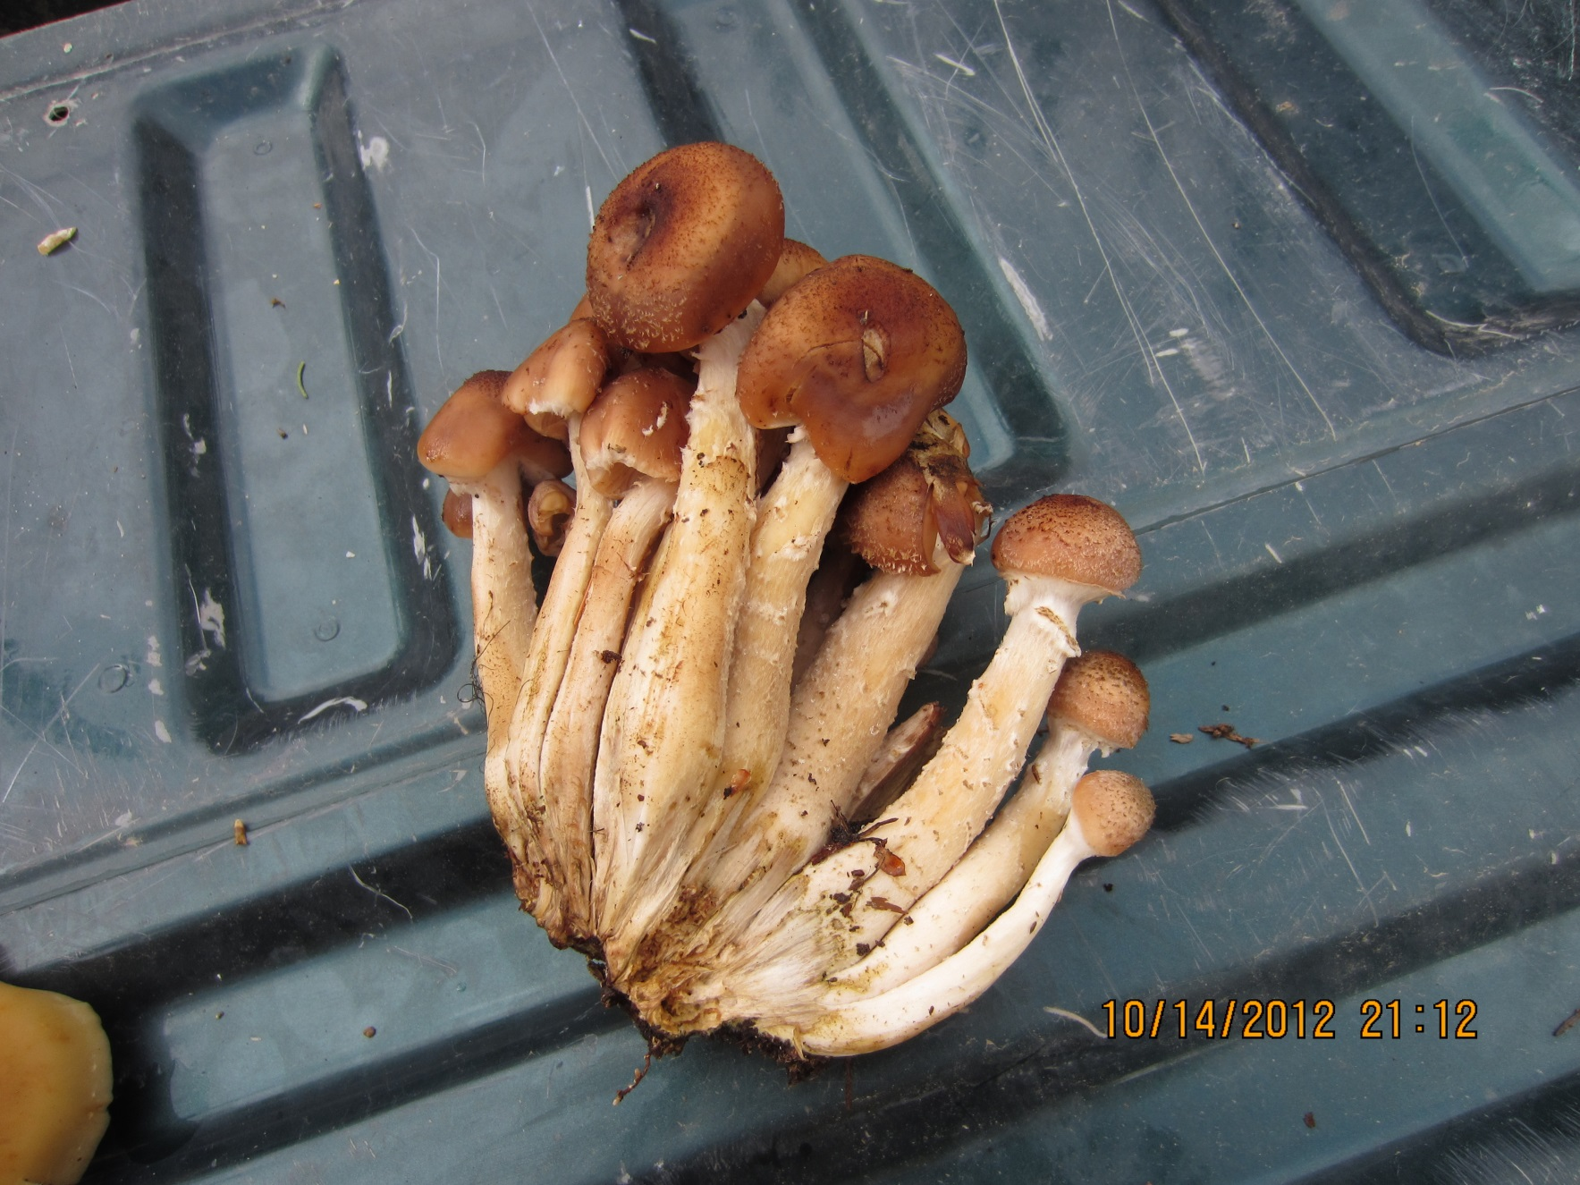
Armillaria mushrooms

Slide 17
Root Disease Management
New root disease management guidebook content finalized but still being edited

Slide 18
Why it’s important to manage for root disease
Good forestry practices can make the problem worse
  Planting right after harvest to a high density of ecologically suitable species (Fd) provides continuous host material in both time and space (feast)
  Trees often planted right next to infected stumps
  For Armillaria, the fungus can spread throughout the root system of an infected tree for about a year after the tree is cut, increasing the amount of infected roots in the soil
  frequent selective harvesting entries can lead to a build up of Armillaria root disease over time
  Avoiding root disease (low volume stands) and selecting healthy (high volume) stands leads to a decrease in the availability of healthy mature stands over time

Slide 19
In natural stands root disease remains relatively constant over time
Natural root rot centers often have a low density of susceptible species and there is often a long regen delay period (famine)
Less susceptible and often less desirable timber species such as birch and aspen have a competitive advantage (also shrub species)
Infected live trees actively fight off and limit the spread of root disease
Healthy pockets emerge inside larger centers to replace newly infected trees along the edges of centers

Slide 20
Root Disease Management Process
1. Identify hazard
2. Conduct survey
3. Stratify
4. Weigh options based on resource values
5. Make decision
6. Treat (or not)
7. Monitor

Slide 21
Root Disease Treatment Options
Two main approaches
1) plant with less susceptible species (often a challenge in drier IDF and MDWR)
2) remove root disease inoculum through stumping (expensive and not suitable on some sites)

Slide 22
Host Susceptibility from guidebook
Common Name | Relative Susceptibility |  |  |  |  | Reference
 | Highly Susceptible | Intermediately Susceptible | Tolerant 1 | Resistant 1 | Immune
Armillaria root disease | subalpine fir | lodgepole pine | mature larch | hardwoods | none | Cleary et al. 2008; Morrison et al. 1992
 | Douglas-fir | western white pine | western redcedar
 | spruce | western hemlock
 |  | ponderosa pine
Laminated root disease | Douglas-fir | western hemlock | pines | western redcedar | hardwood | Thies & Sturrock 1995; Sturrock et al. 2006; Cleary et al. 2011
 | grand fir | western larch |  | yellow cedar
 | amabilis fir | subalpine fir
 | mtn. hemlock | Sitka spruce
 |  | Engelmann spruce

Slide 23
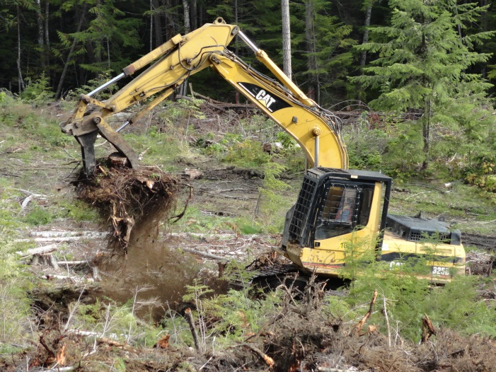
Stumping
Most published and a number of Ministry unpublished studies show significant increases in growth and decreases in root rot mortality following stumping (MM unpublished 29% increase in growth and 54% less Armillaria 13 sites)
          Growth effect in large part due to mixing of organic and mineral soil layers

Slide 24
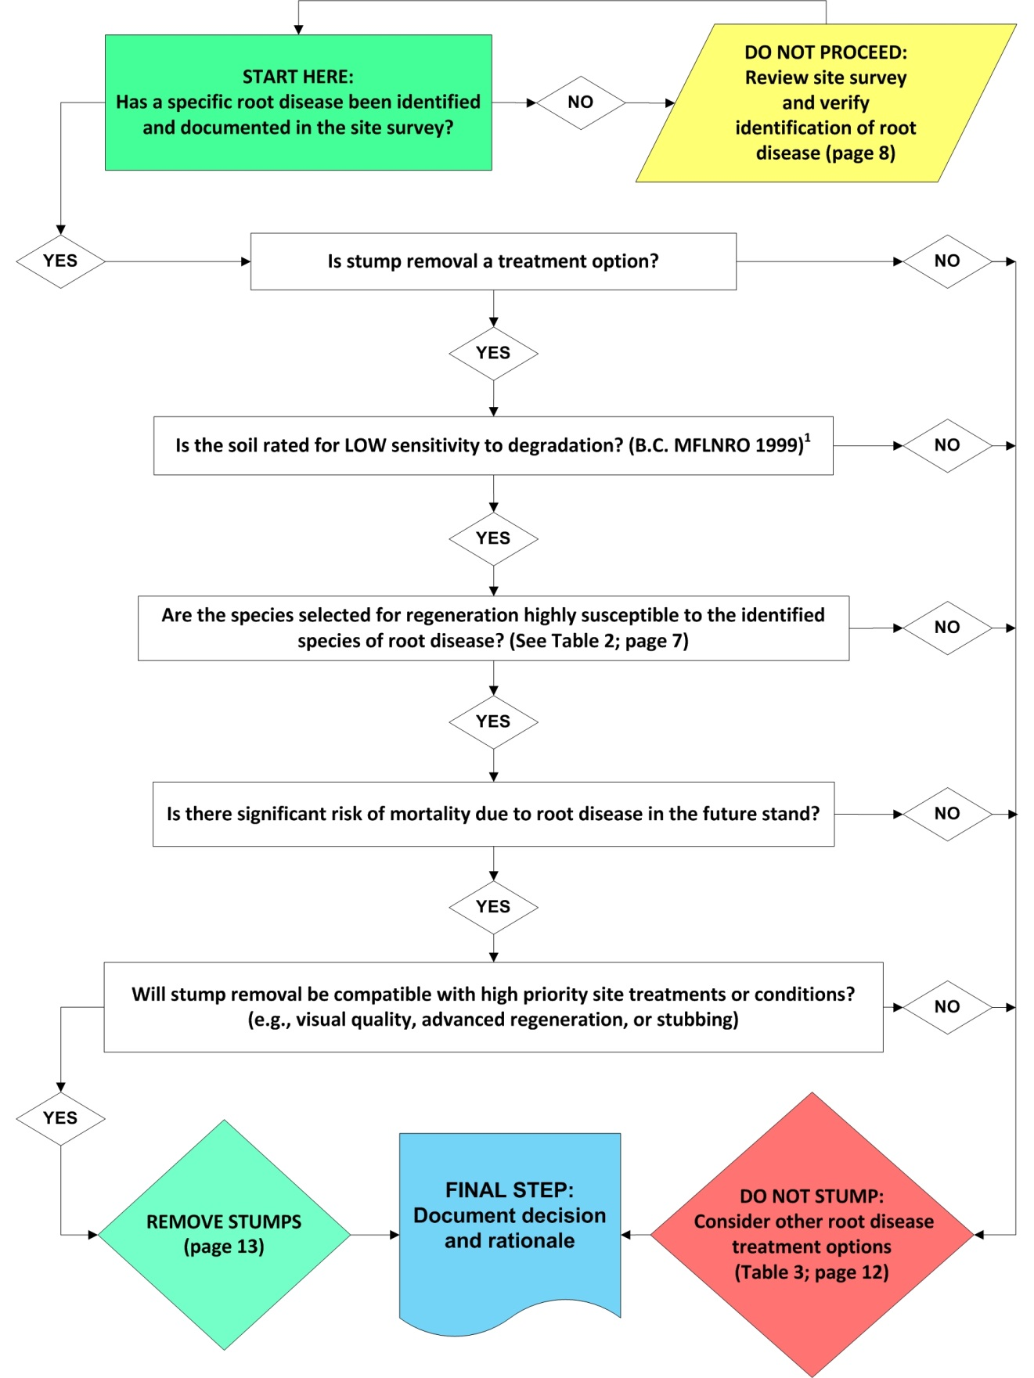

Slide 25
Experimental Approaches (not currently recommended)
Hypholoma
  bags of sawdust containing Hypholoma inoculum placed next to stumps resulted in a significant reduction in root disease on two of six trial sites (Chapman 2004)
  Also resulted in significant reduction on one Kootenay site though not as effective as stumping (unpublished)
  Expensive to do testing necessary to get regulatory approval (needs to go through same testing procedure as a pesticide) but little financial incentive for anyone to do the testing
  each strain used must be tested separately can’t just go out and collect a bunch of wild strains
  Would require somebody to produce it commercially
  Cultured strains can lose their ability to aggressively colonize roots over time

Slide 26
Experimental approaches not currently recommended cont’d
Ringbarking
- girdling tree prior to harvesting could reduce root starches and might limit spread of Armillaria in root cambium post harvest and favour saprophytic root colonizers like Hypholoma
- needs further testing to see if it’s effective

Slide 27
Conclusions
Diseases of the site
Intensive forest management can lead to an intensification over time if root rot not managed
Management starts with recognition of hazard and good mapping/survey information
Weigh treatment options against management objectives
Treat by planting less susceptible species or stumping where appropriate
Monitor effectiveness of treatments

